Slide 1
BCCA figures
March 13 2025

Slide 2
Data % to report
X2.1.Flow.Type n prop
<chr> <int> <dbl>
1 Biotic 113 0.551
2 Human movement 21 0.102
3 Physical 38 0.185
4 Sociocultural 33 0.161

Slide 3
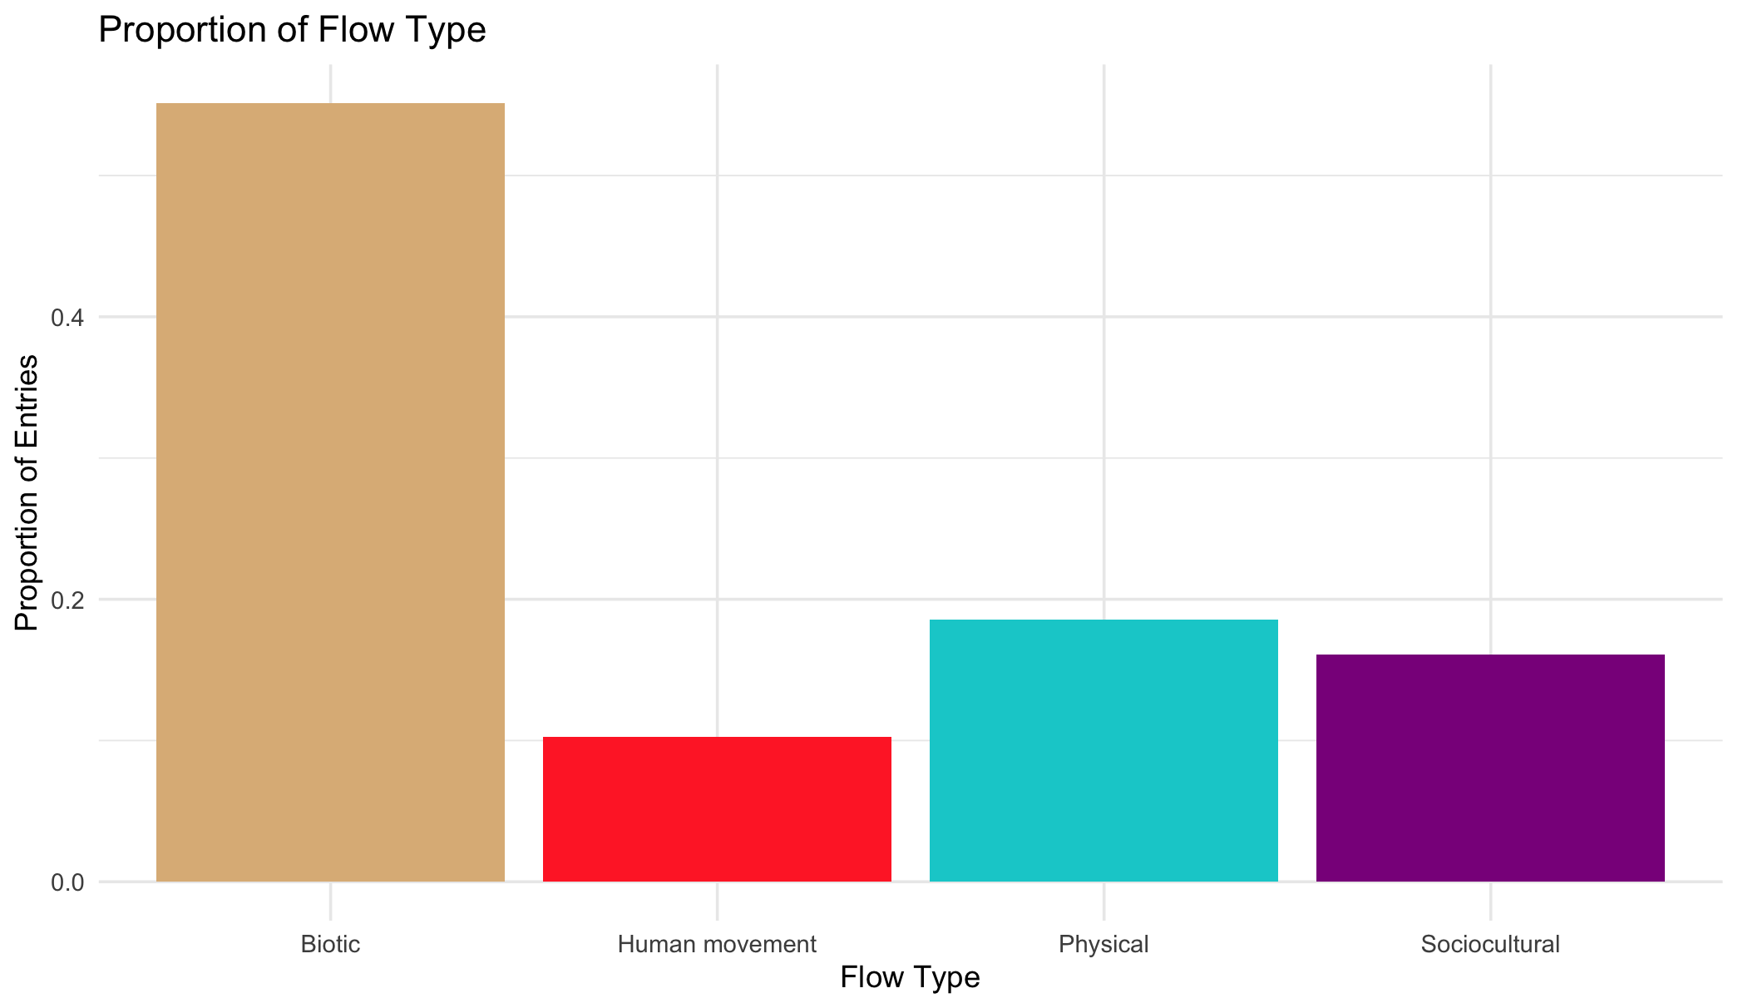

Slide 4
Multiple flows
Another.Flow. n prop
1 No 168 0.820
2 Yes 37 0.180

Slide 5
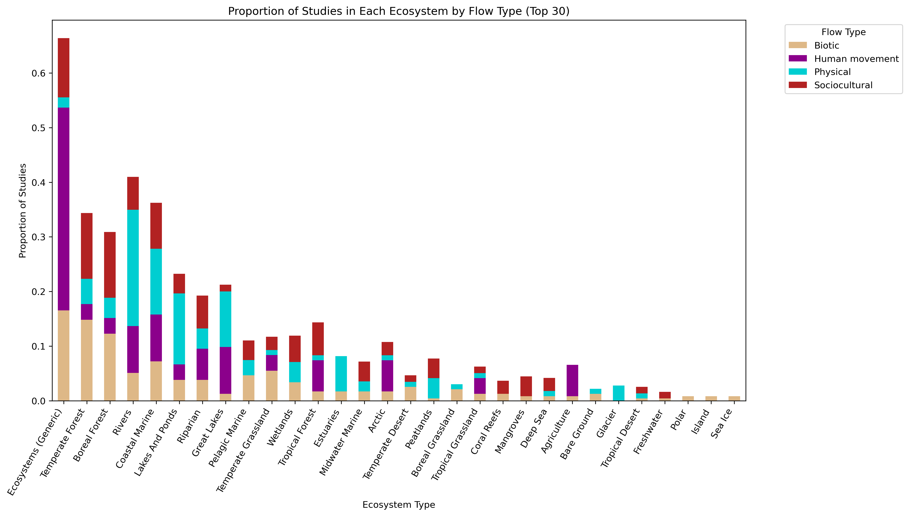
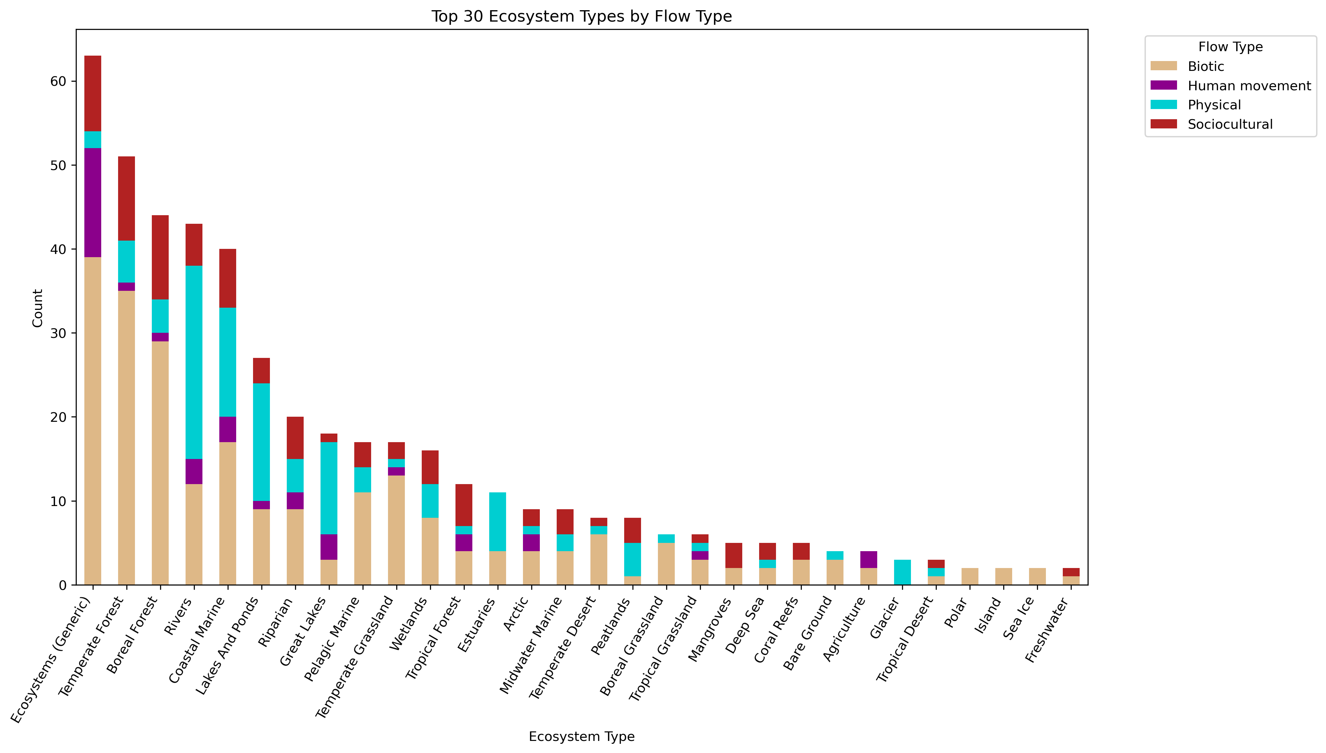

Slide 6
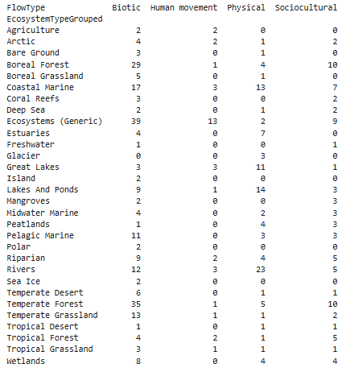
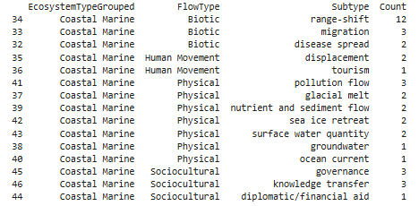

Slide 8
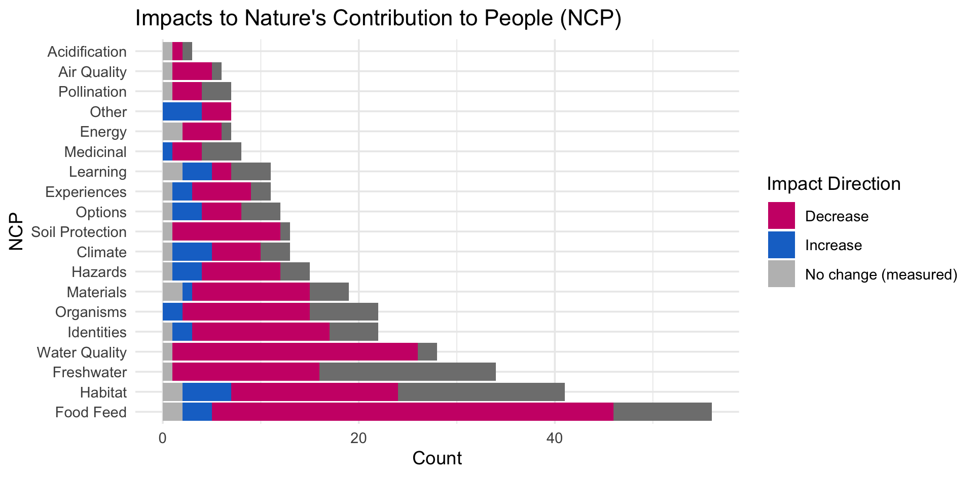

Slide 10
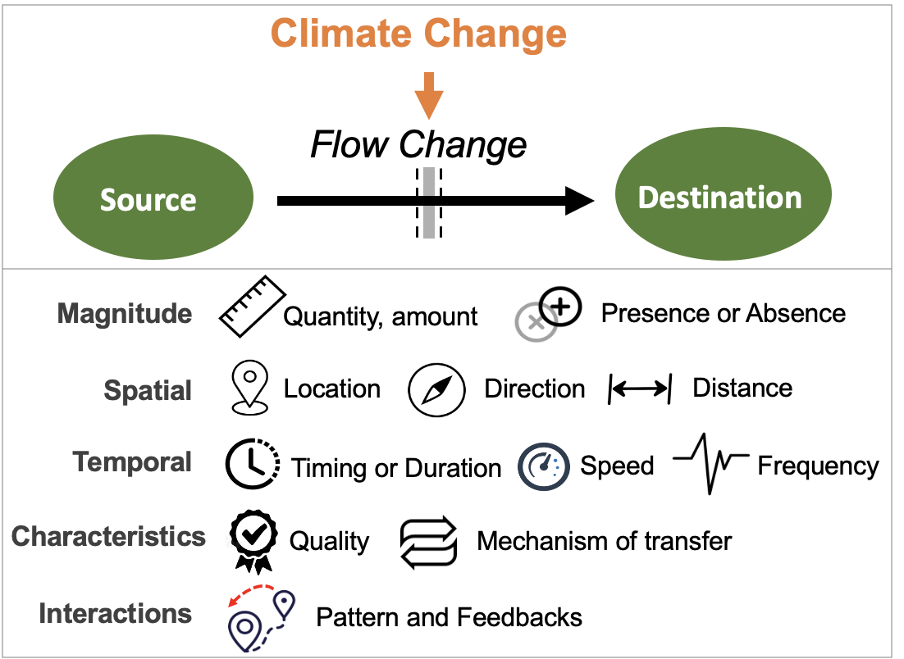
Most common paths
Climate change →

Slide 11
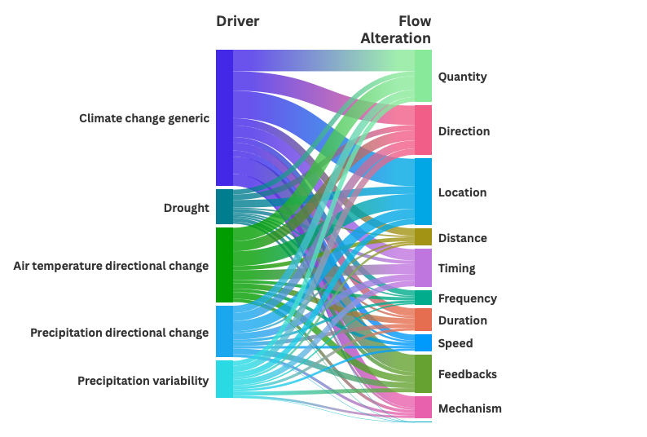

Slide 12
HWB studies
# Cohesion Justice Other Relational Welfare
# 18 21 7 31 76

Slide 13
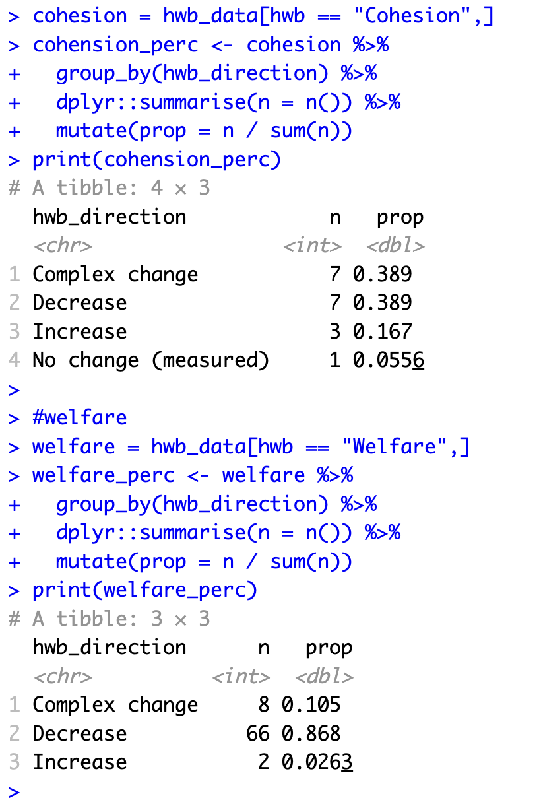
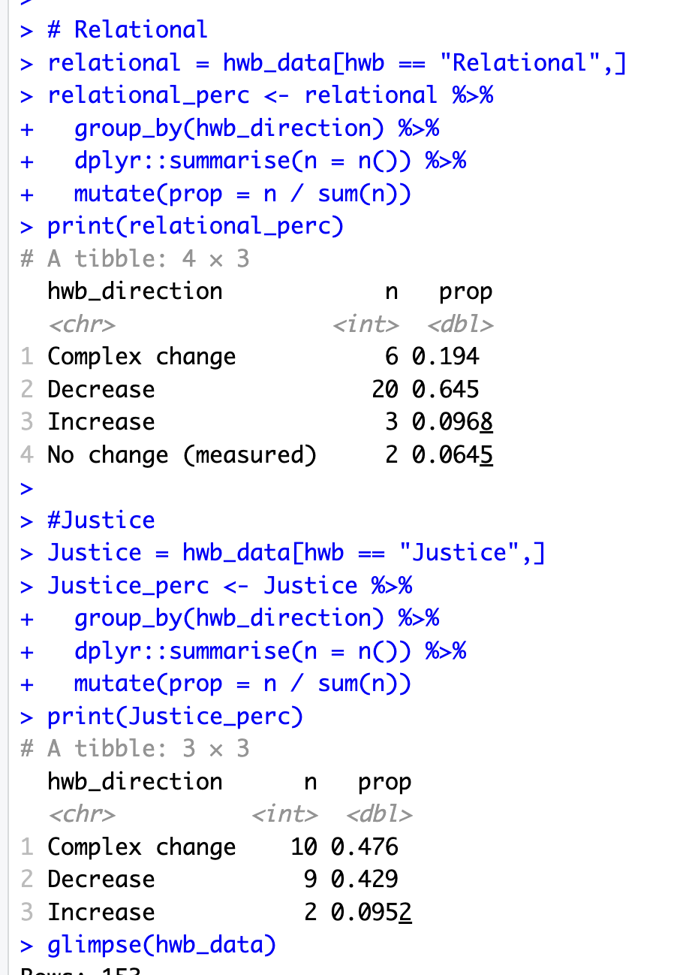

Slide 14
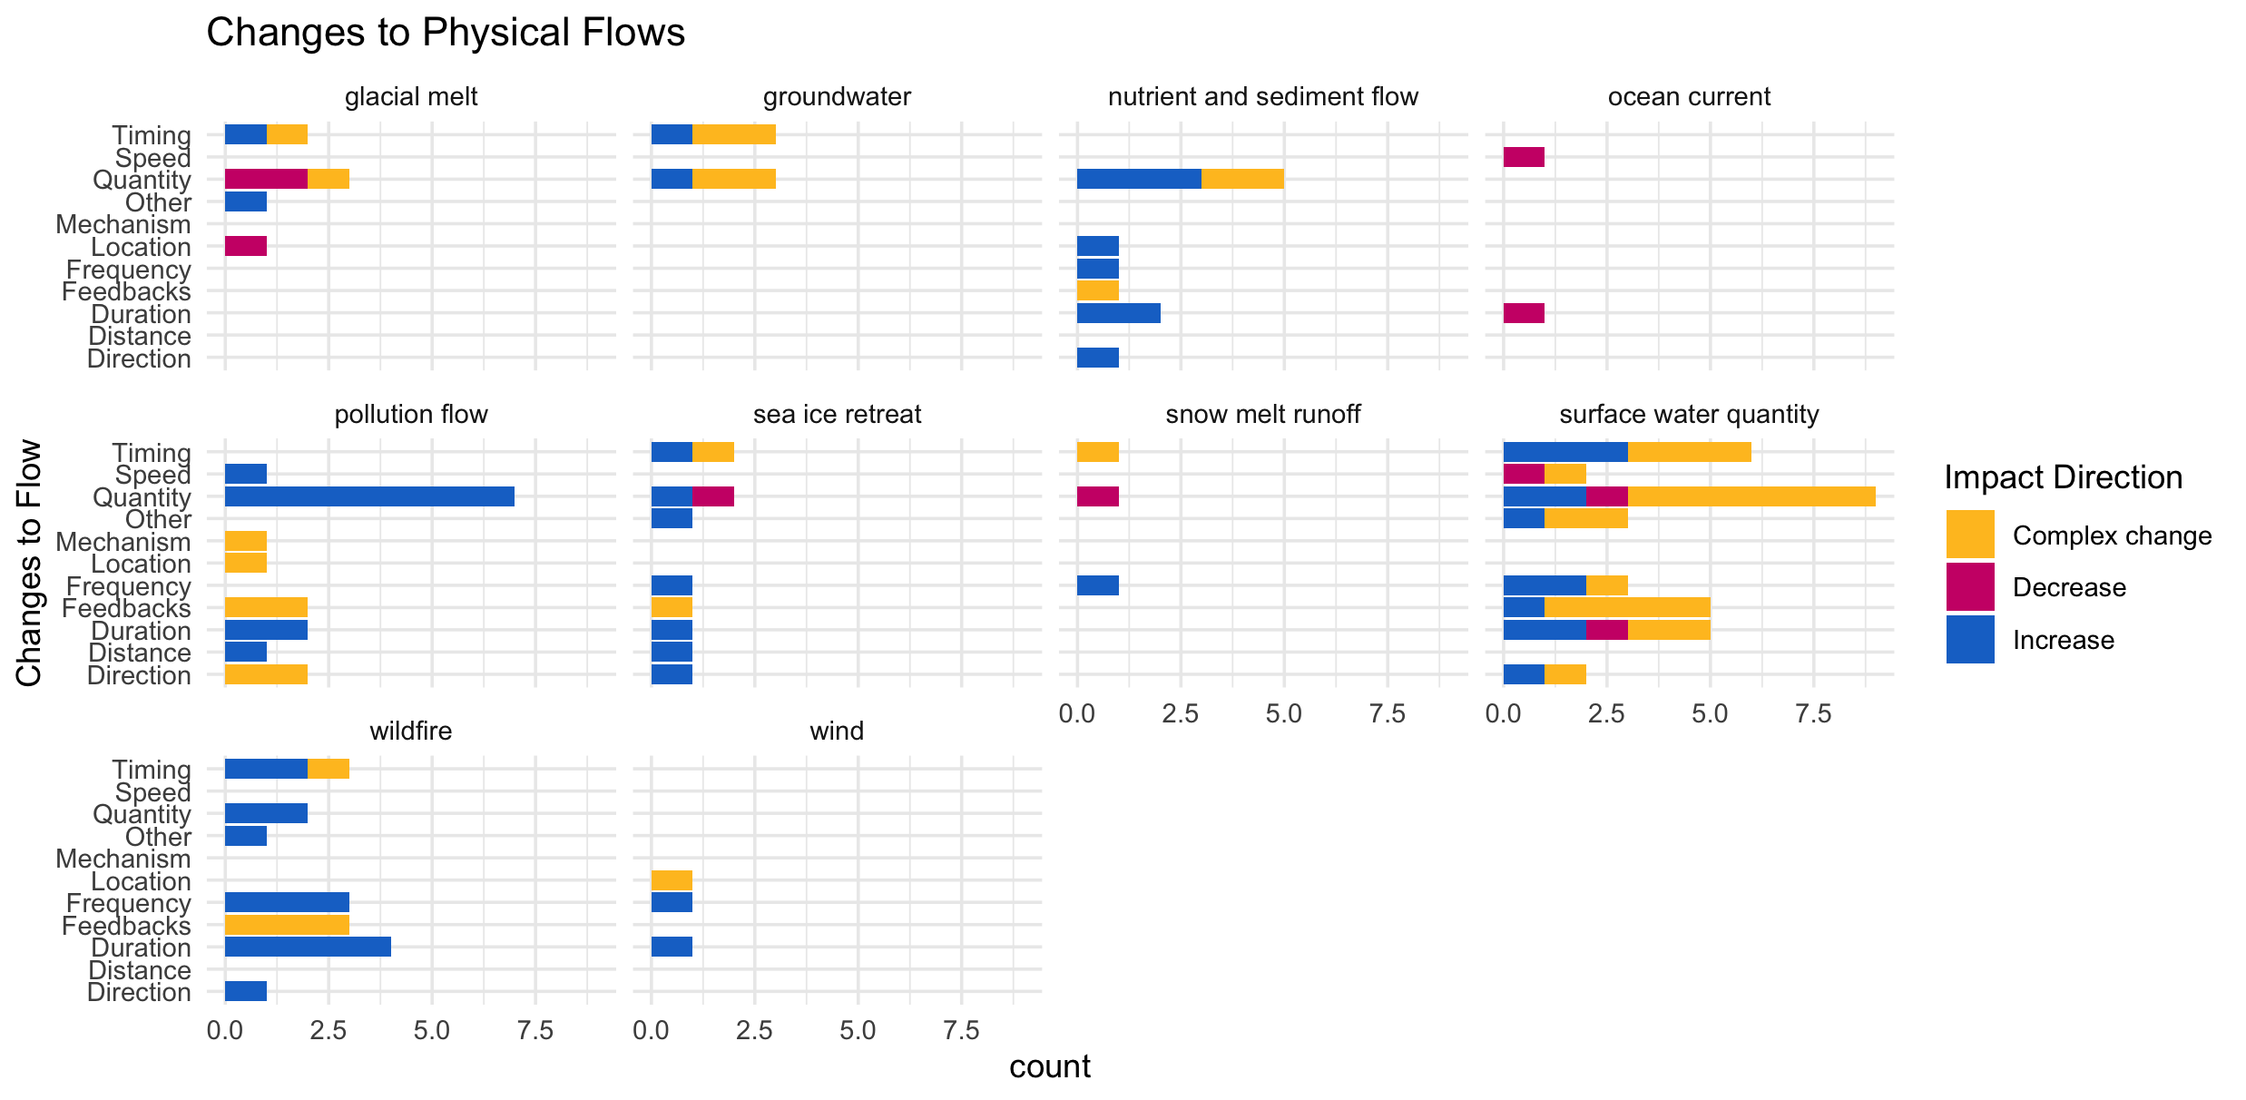

Slide 15
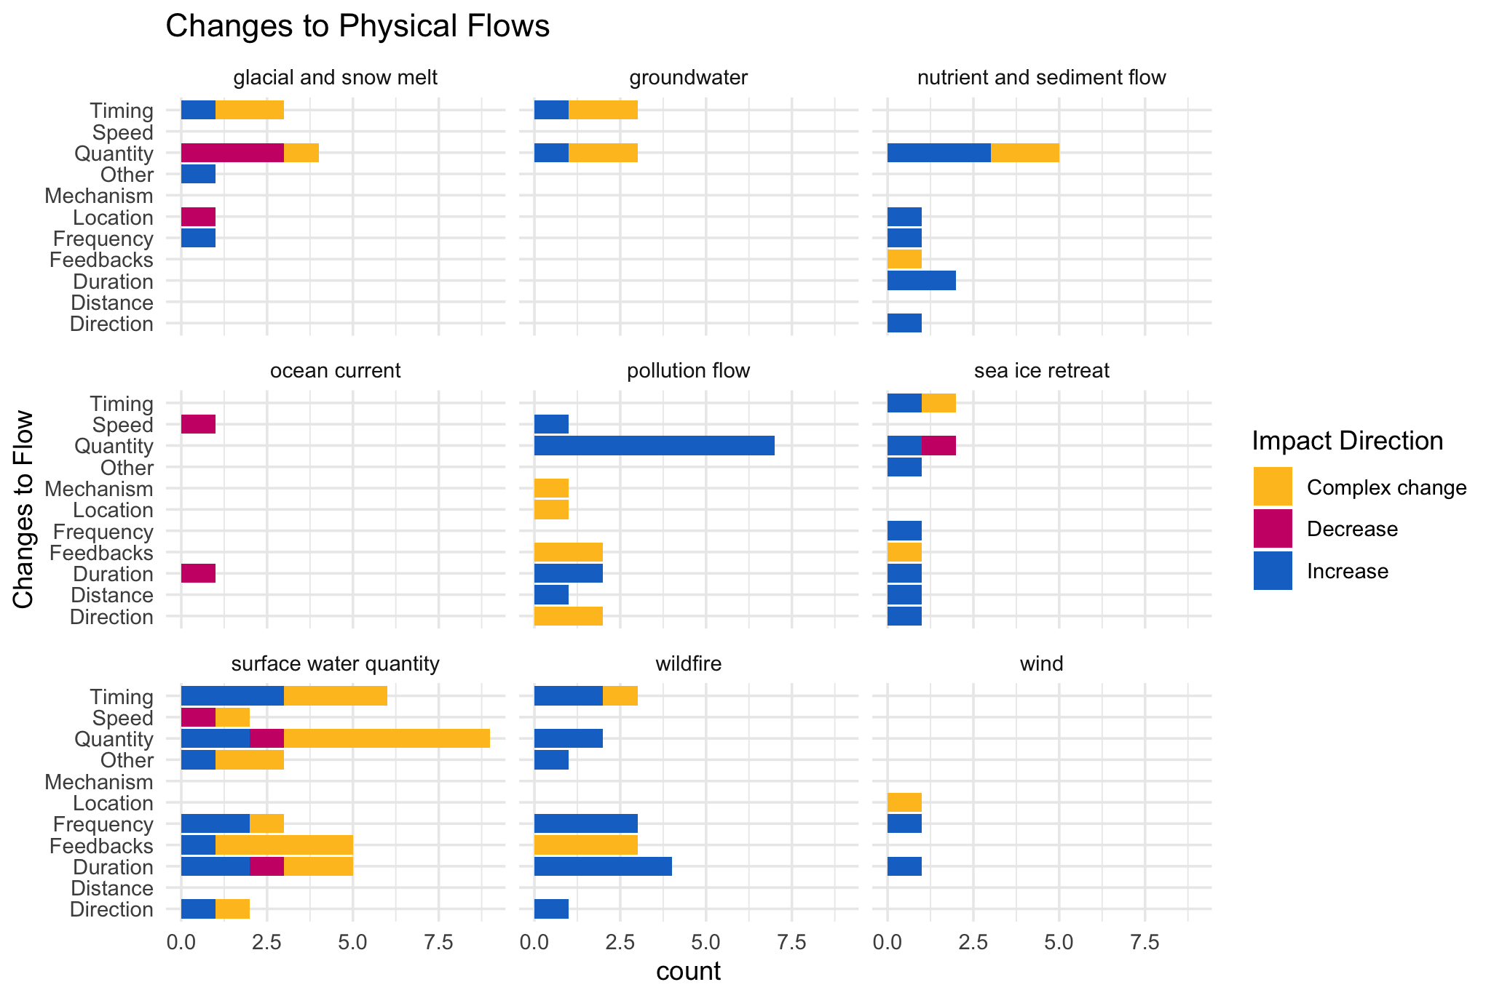

Slide 16
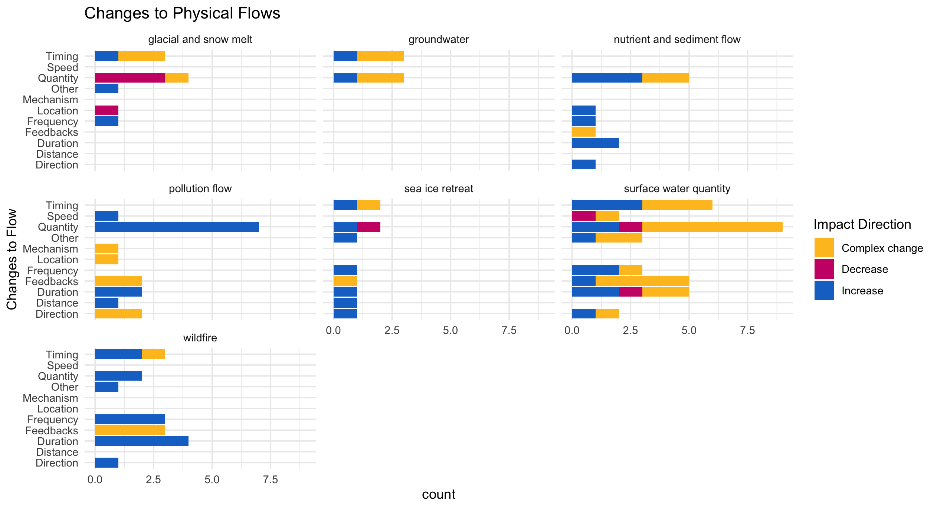

Slide 17
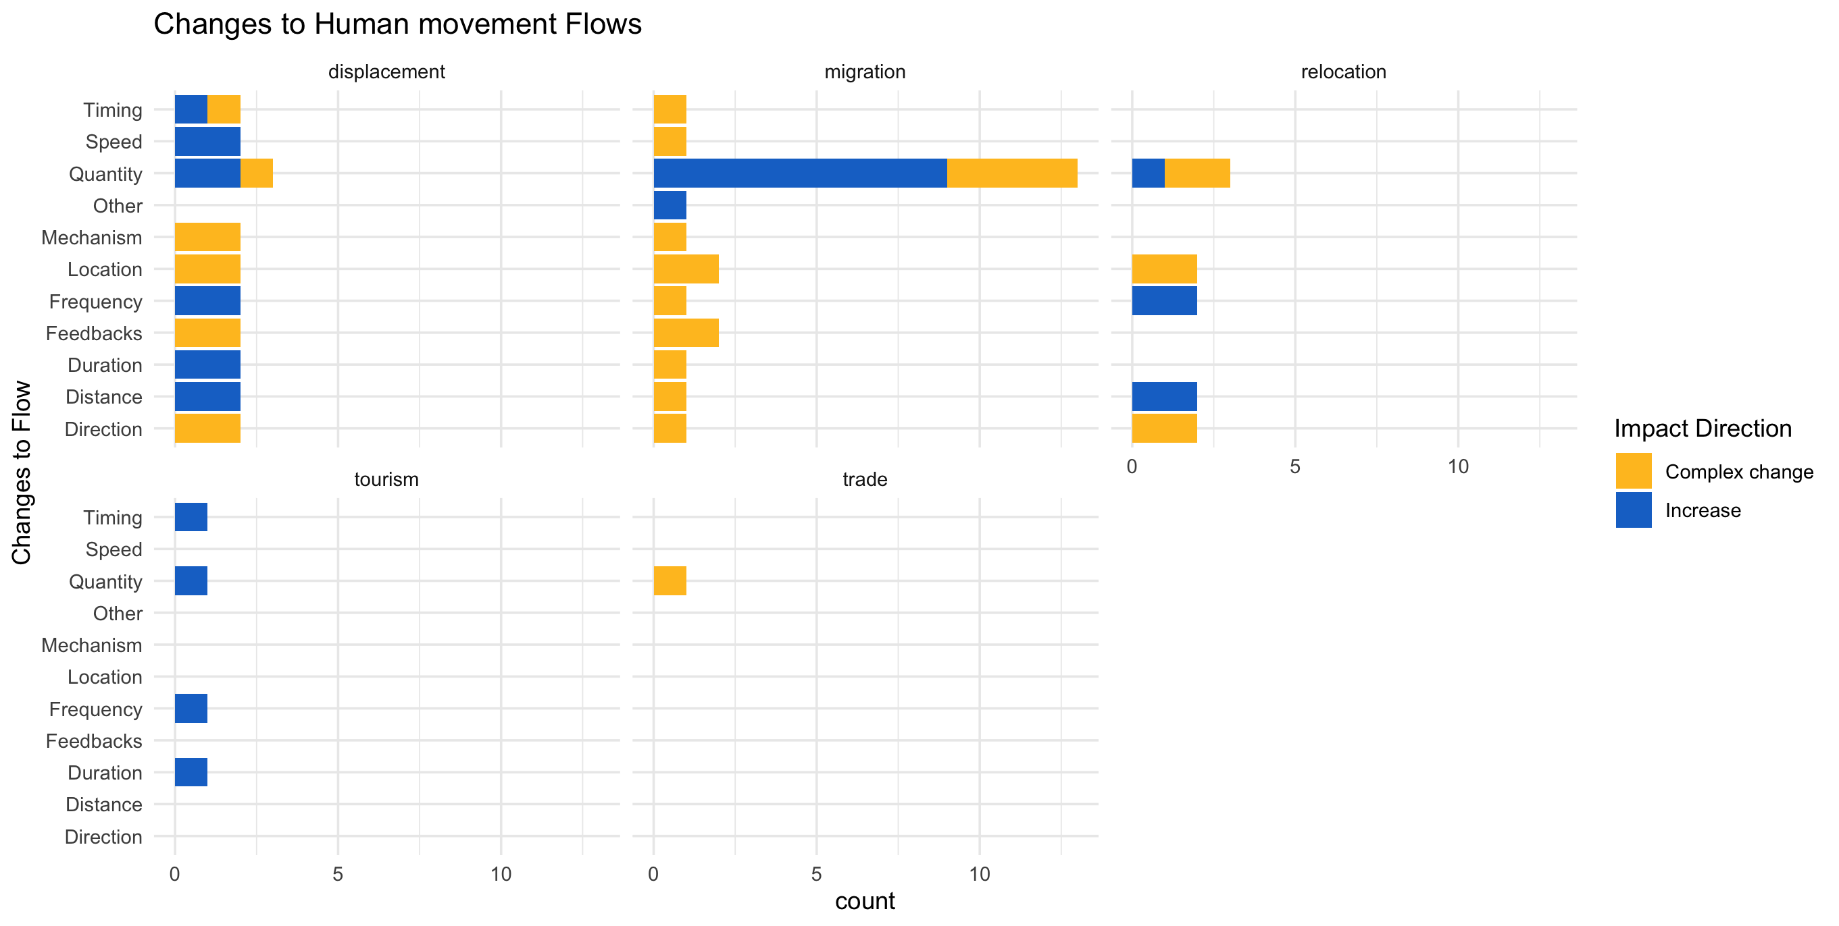

Slide 18
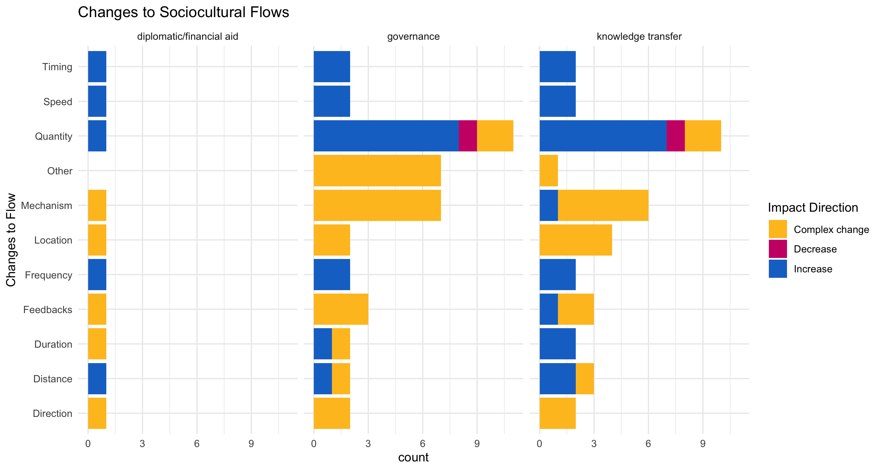

Slide 19
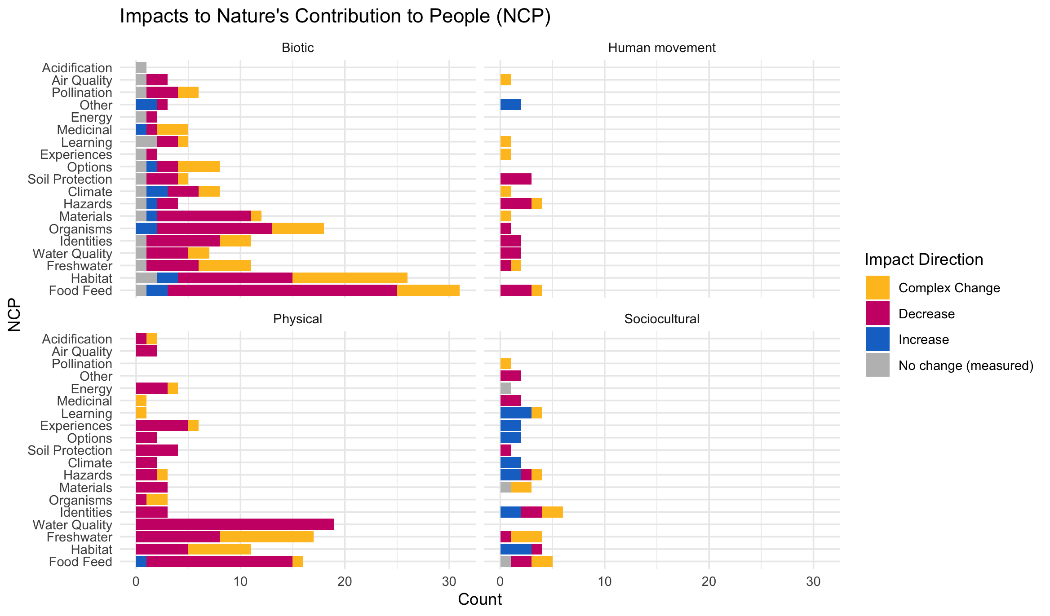

Slide 20
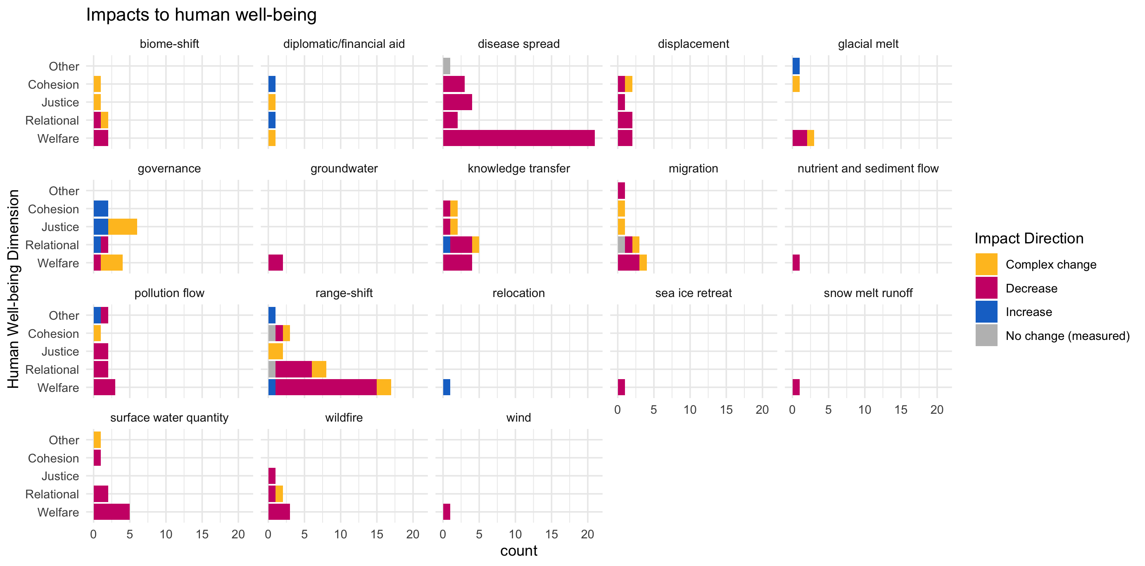

Slide 21
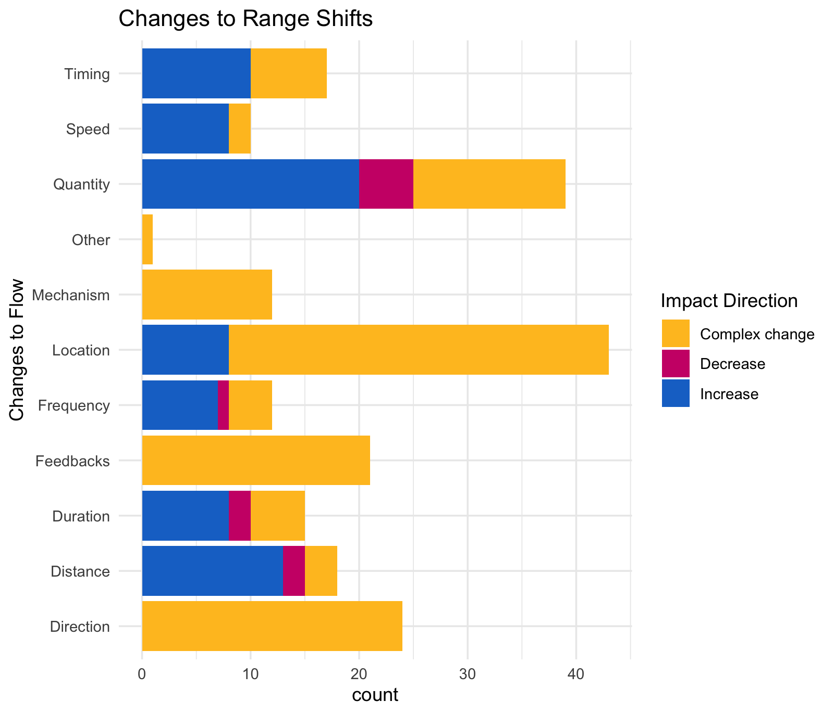

Slide 22
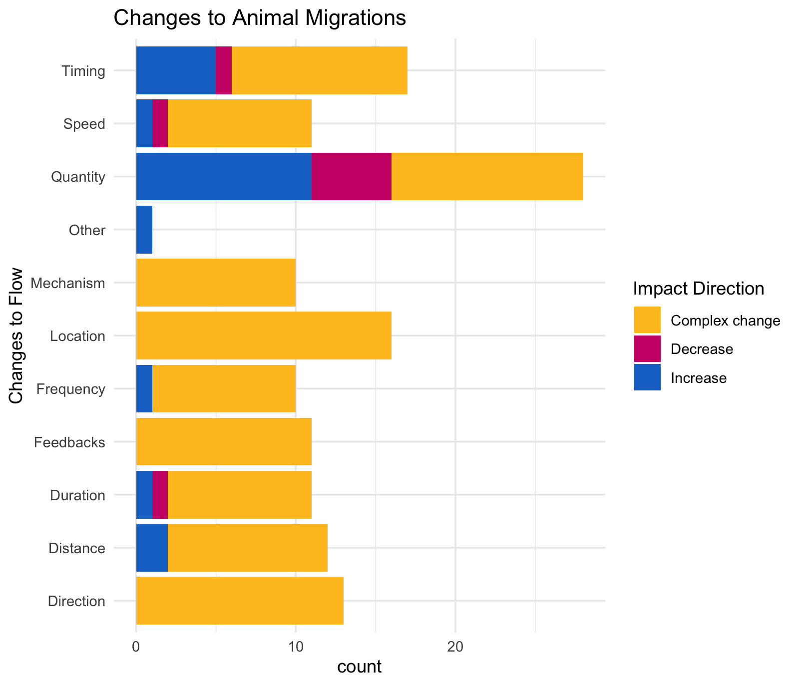

Slide 23
OLDER:

Slide 25
At least 5 entries – top – to get stats on % of entries or papers on these:

Slide 26
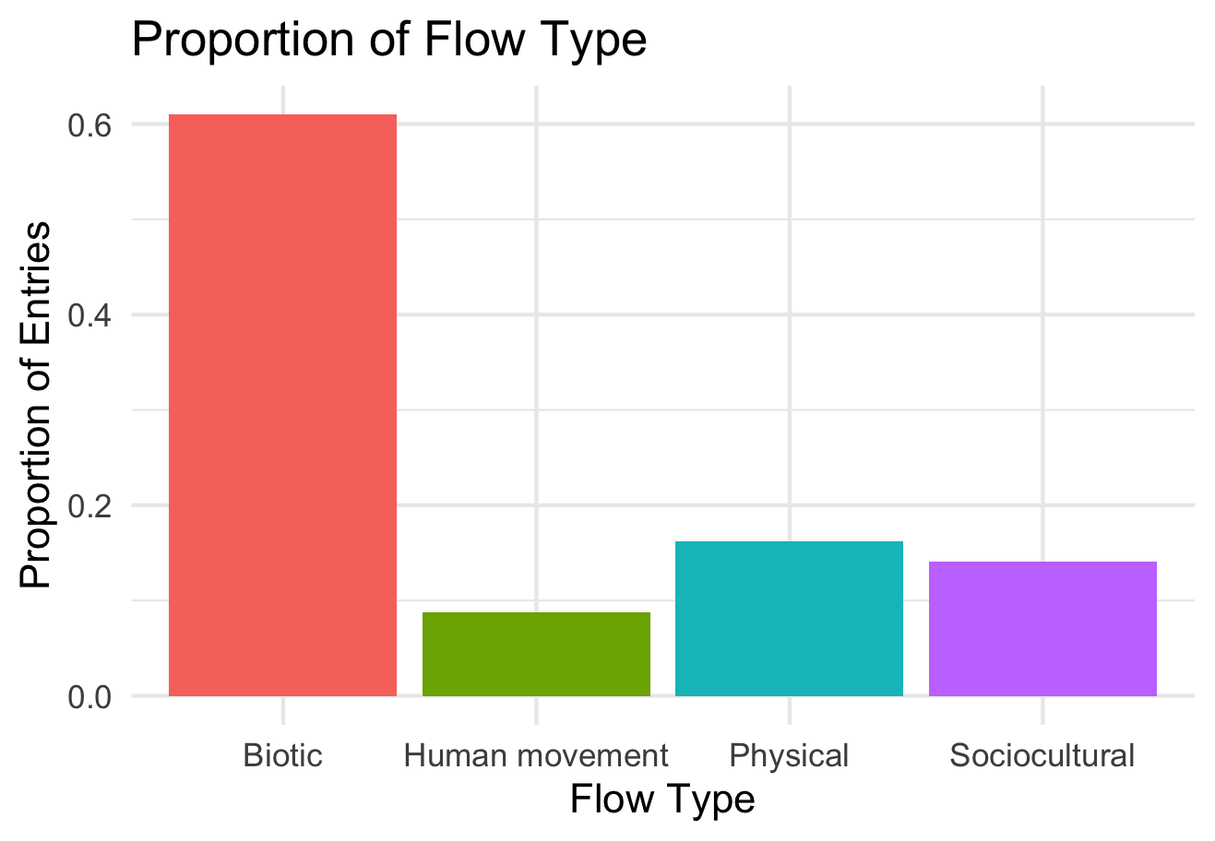

Slide 27
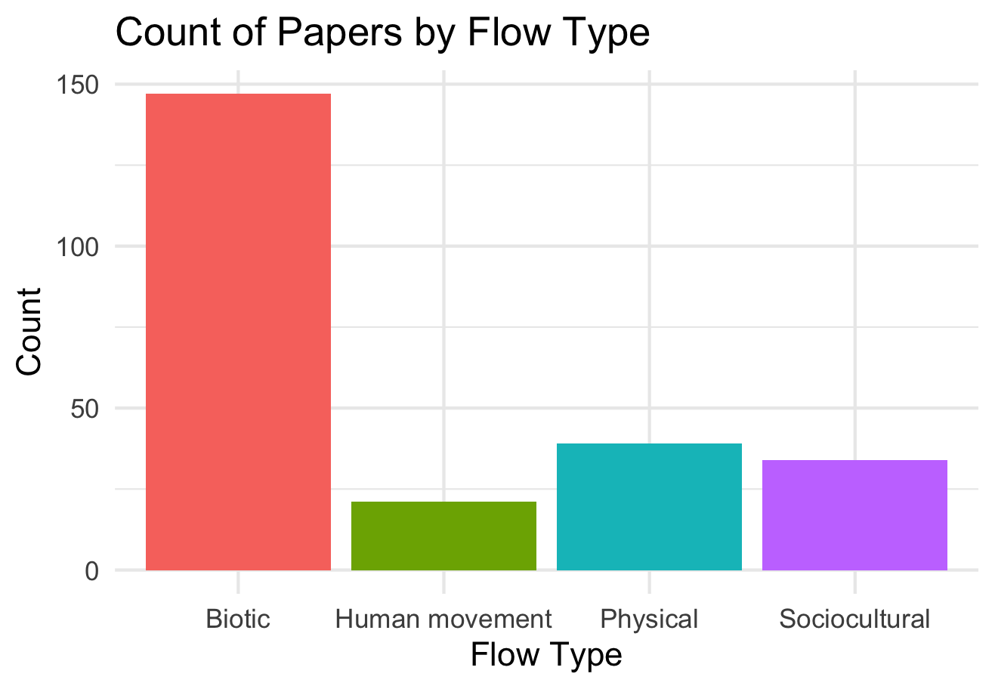

Slide 28
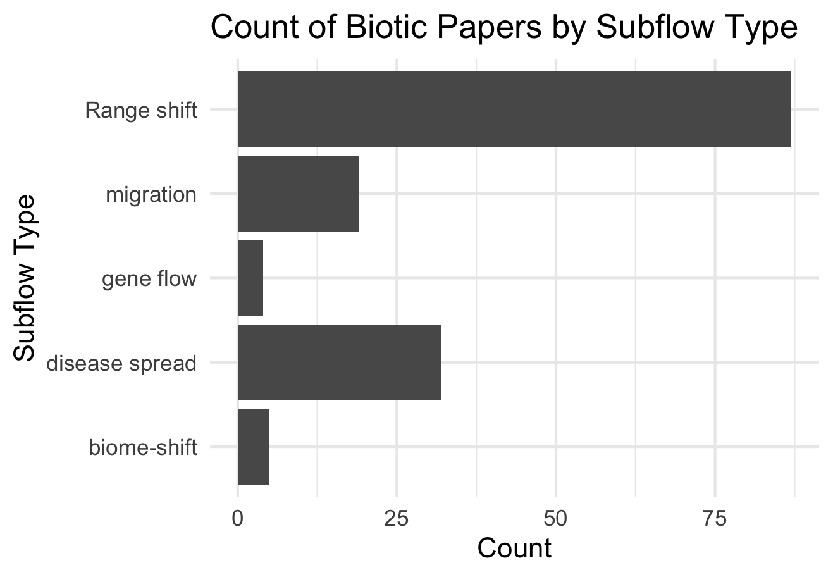

Slide 29
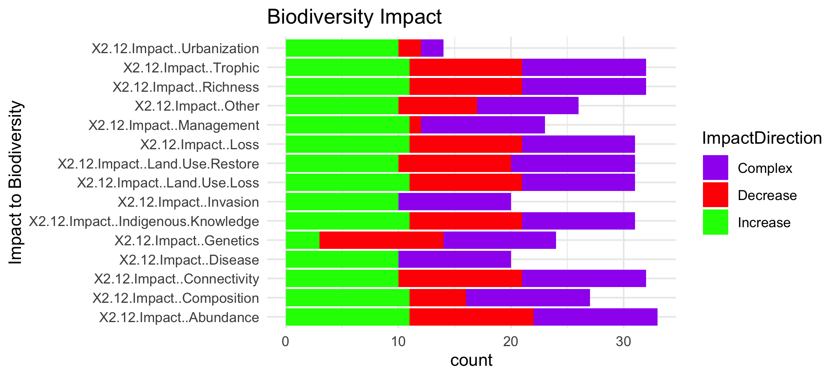

Slide 31
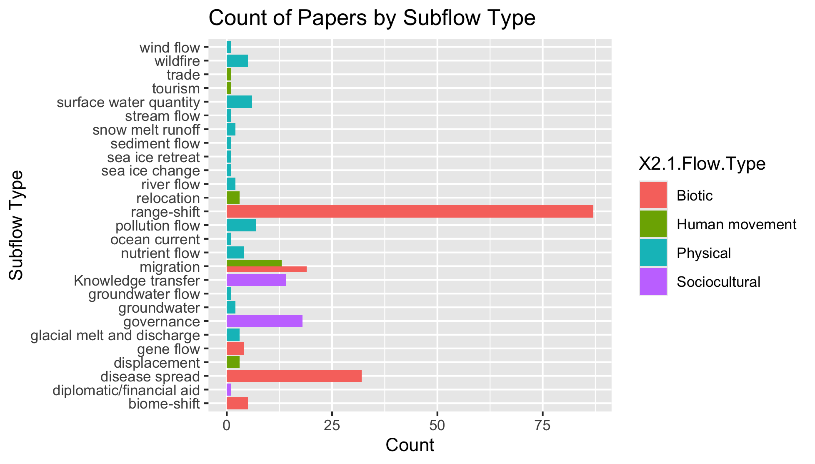
To group physical flow papers

Slide 32
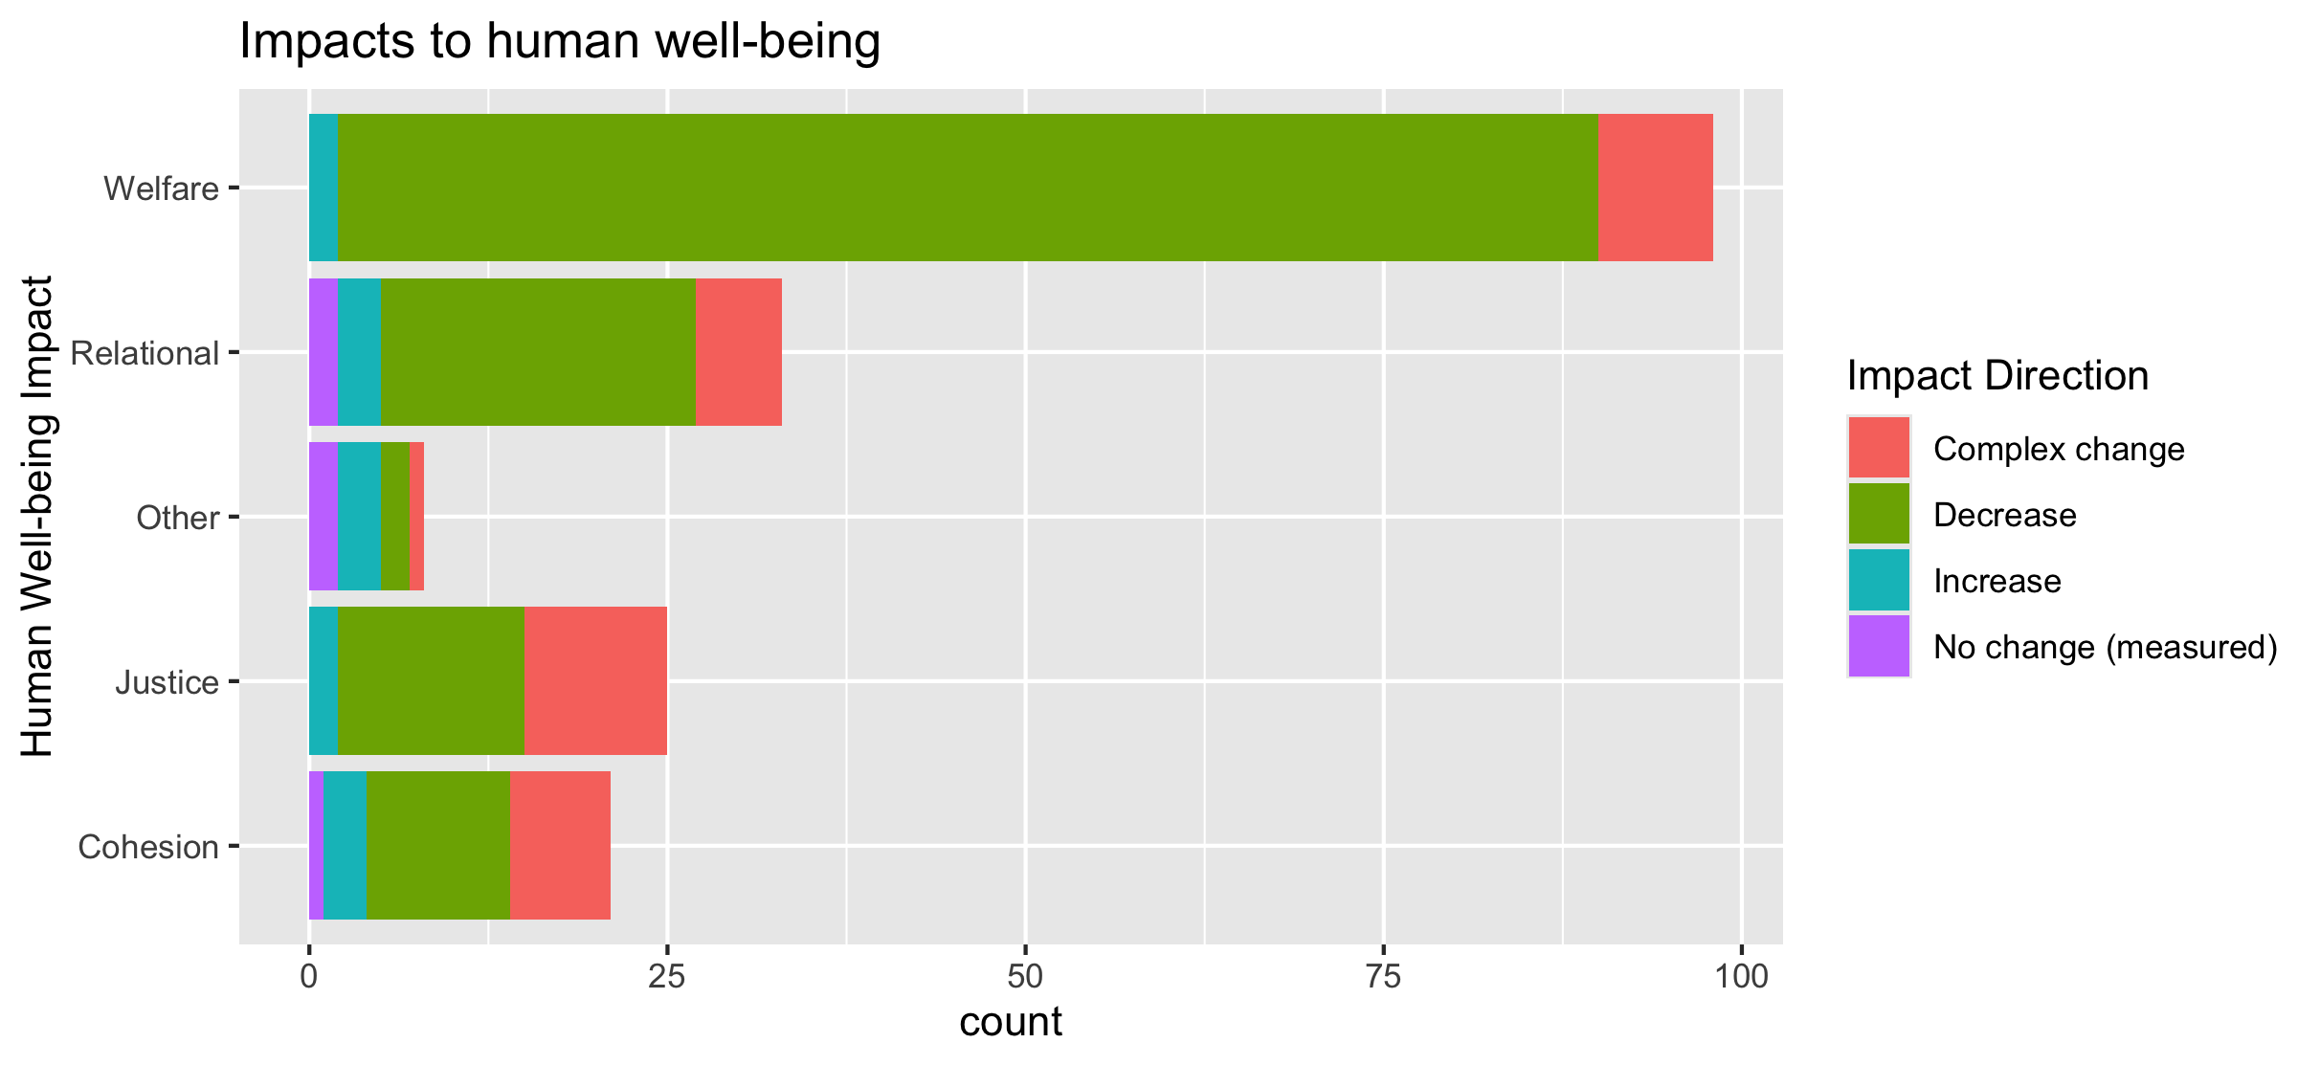
To align direction colors with final color pallet

Slide 33
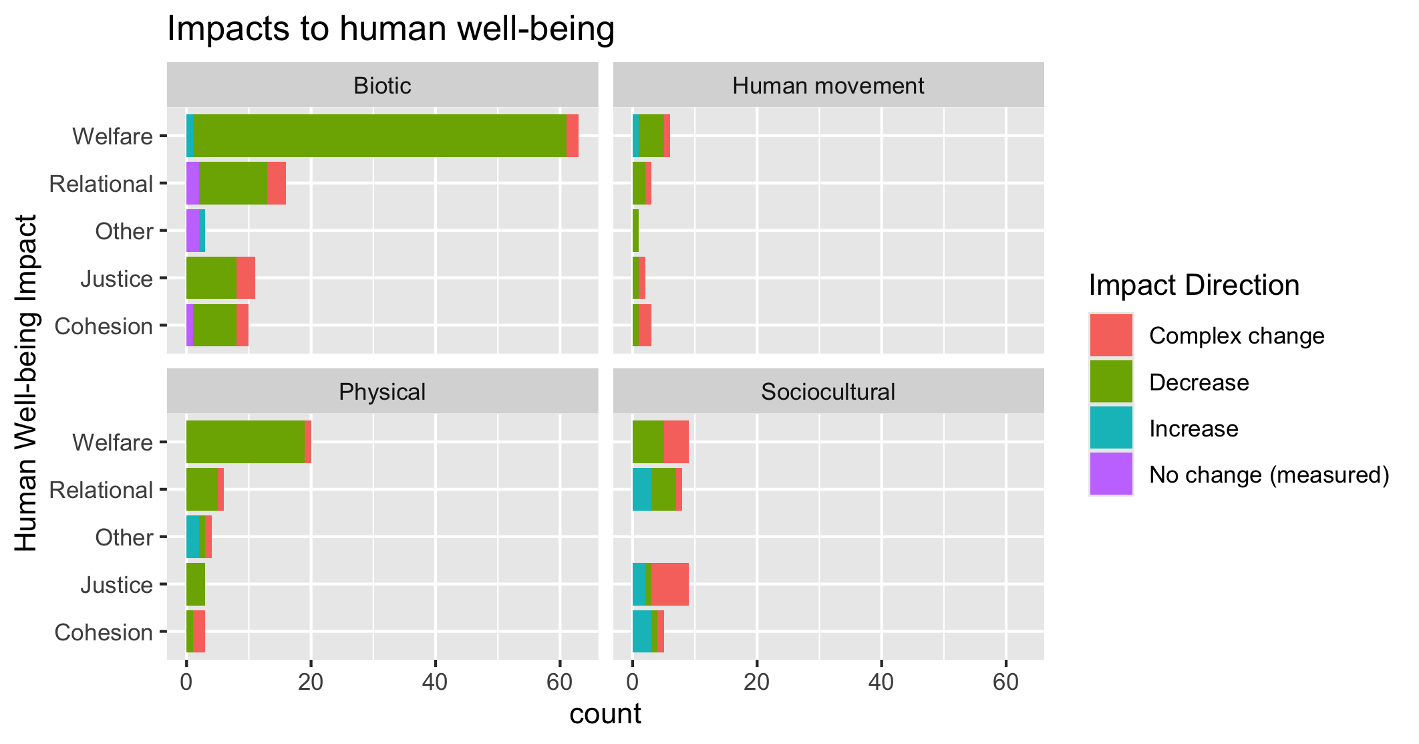
To align direction colors with final color pallet

Slide 34
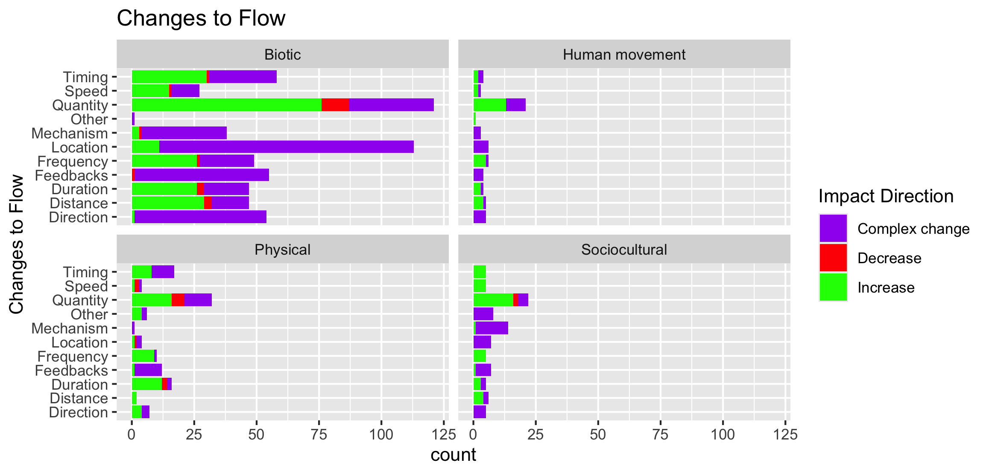

Slide 35
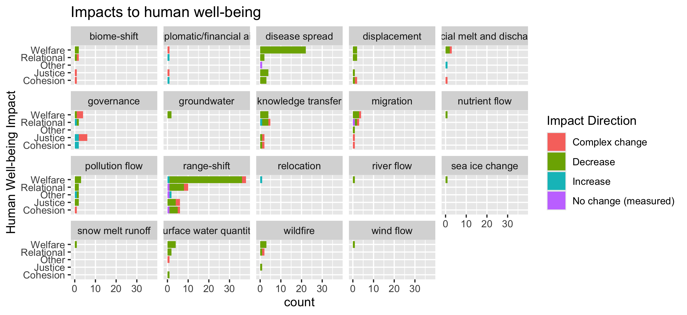
To group physical flow papers

Slide 36
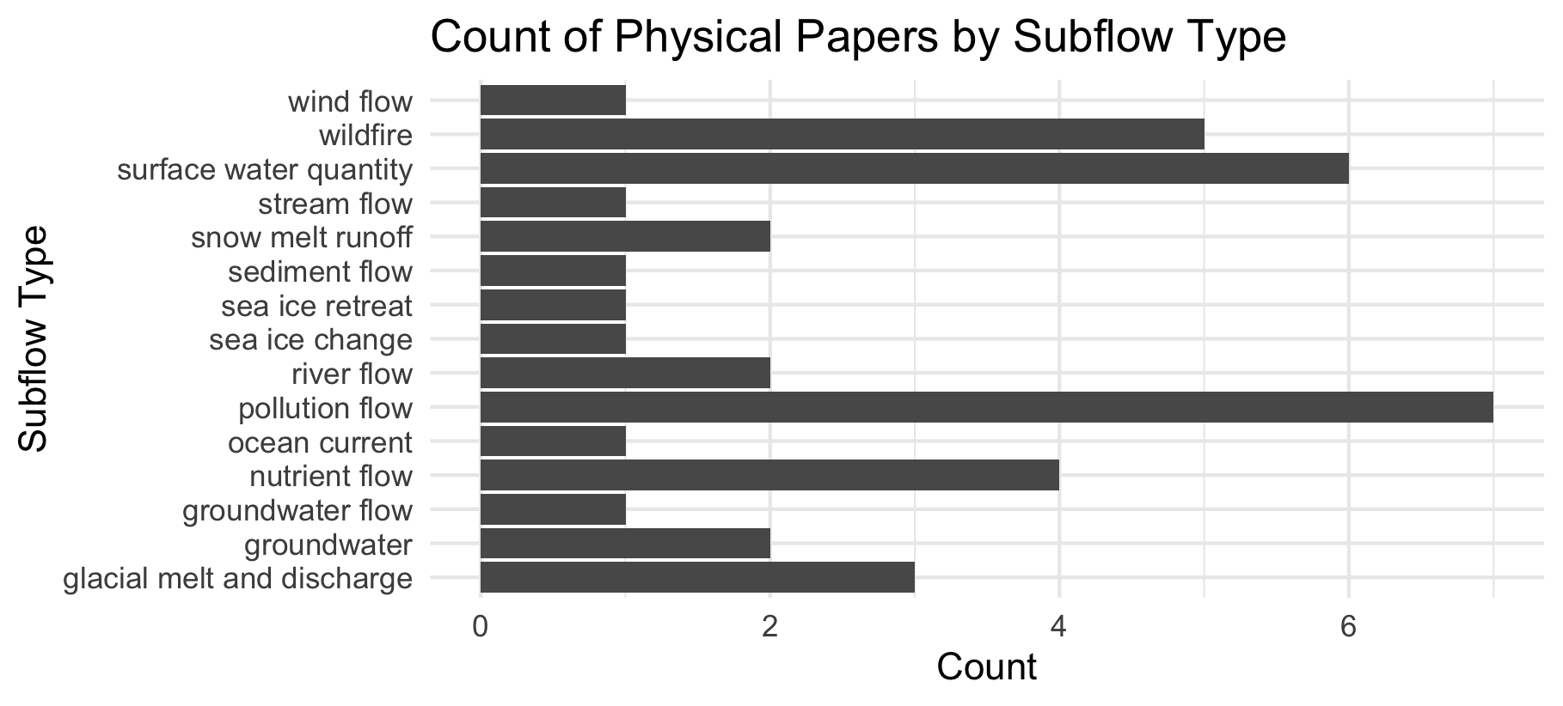

Slide 37
Feb 23 2025

Slide 38
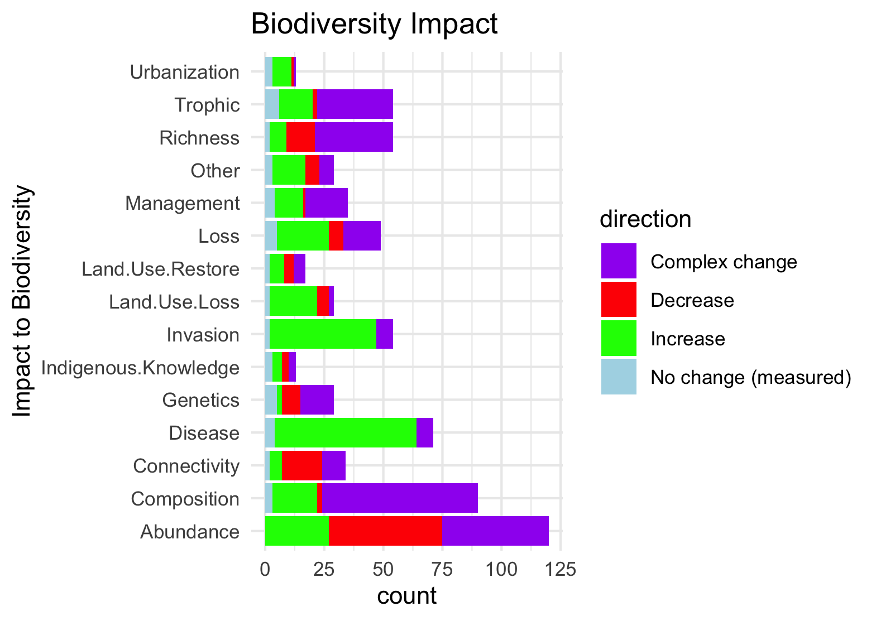
Needs to be grouped by what is good and what is bad to see increase in:

Slide 39
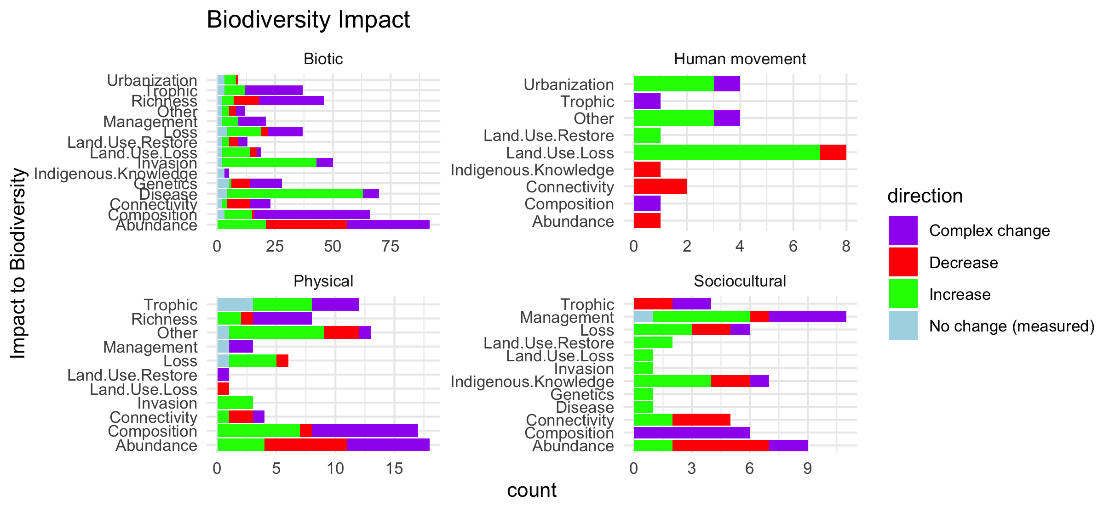
Scale free on the facet (diff x axis)

Slide 40
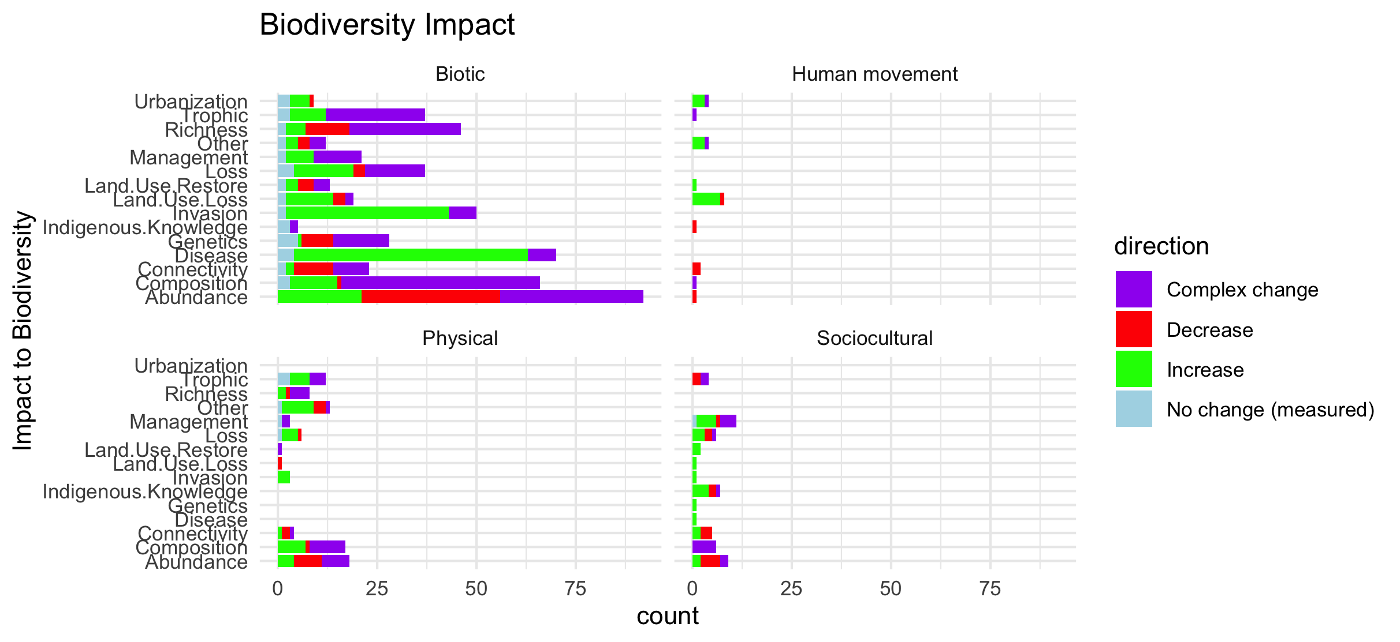
Scale fixed on the facet (same x axis)

Slide 41
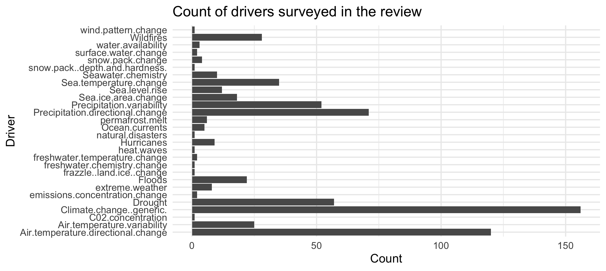

Slide 42
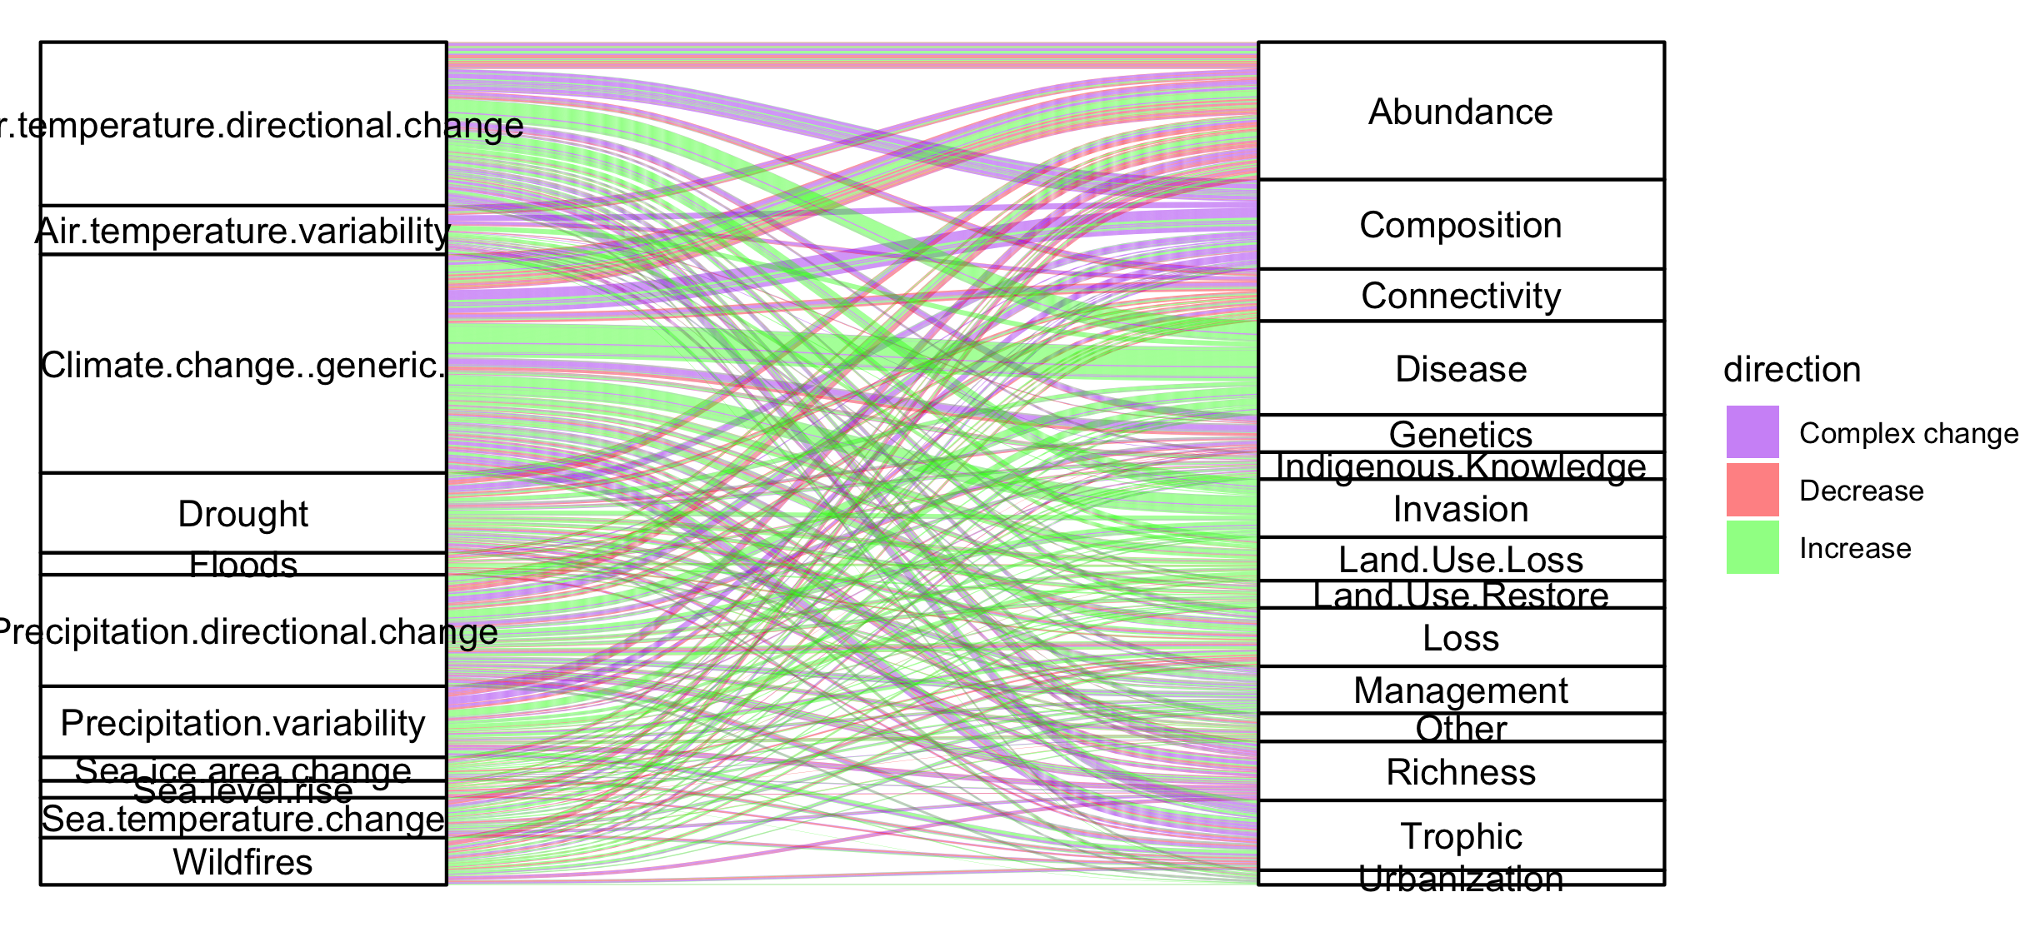
Colleen: see note isn the code – we could group spme of the drivers (hurricaines, extreme weather, ands ome of the ice ones). This still doesnt take into account if changes arw good or bad though and might just be too busy.

Slide 43
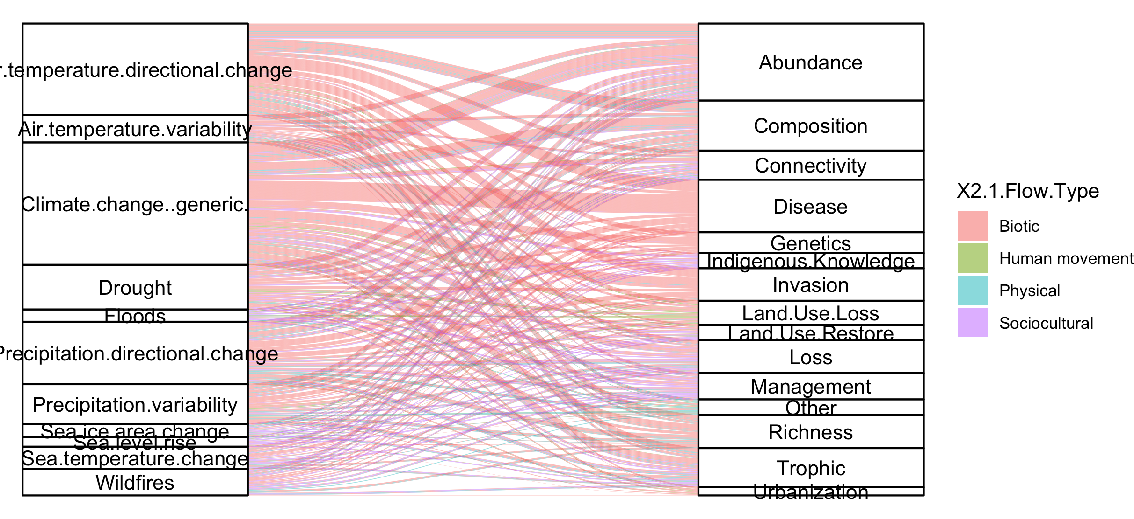
#not that informative because so many more of the papers are biotic

Slide 44
NCPs

Slide 45
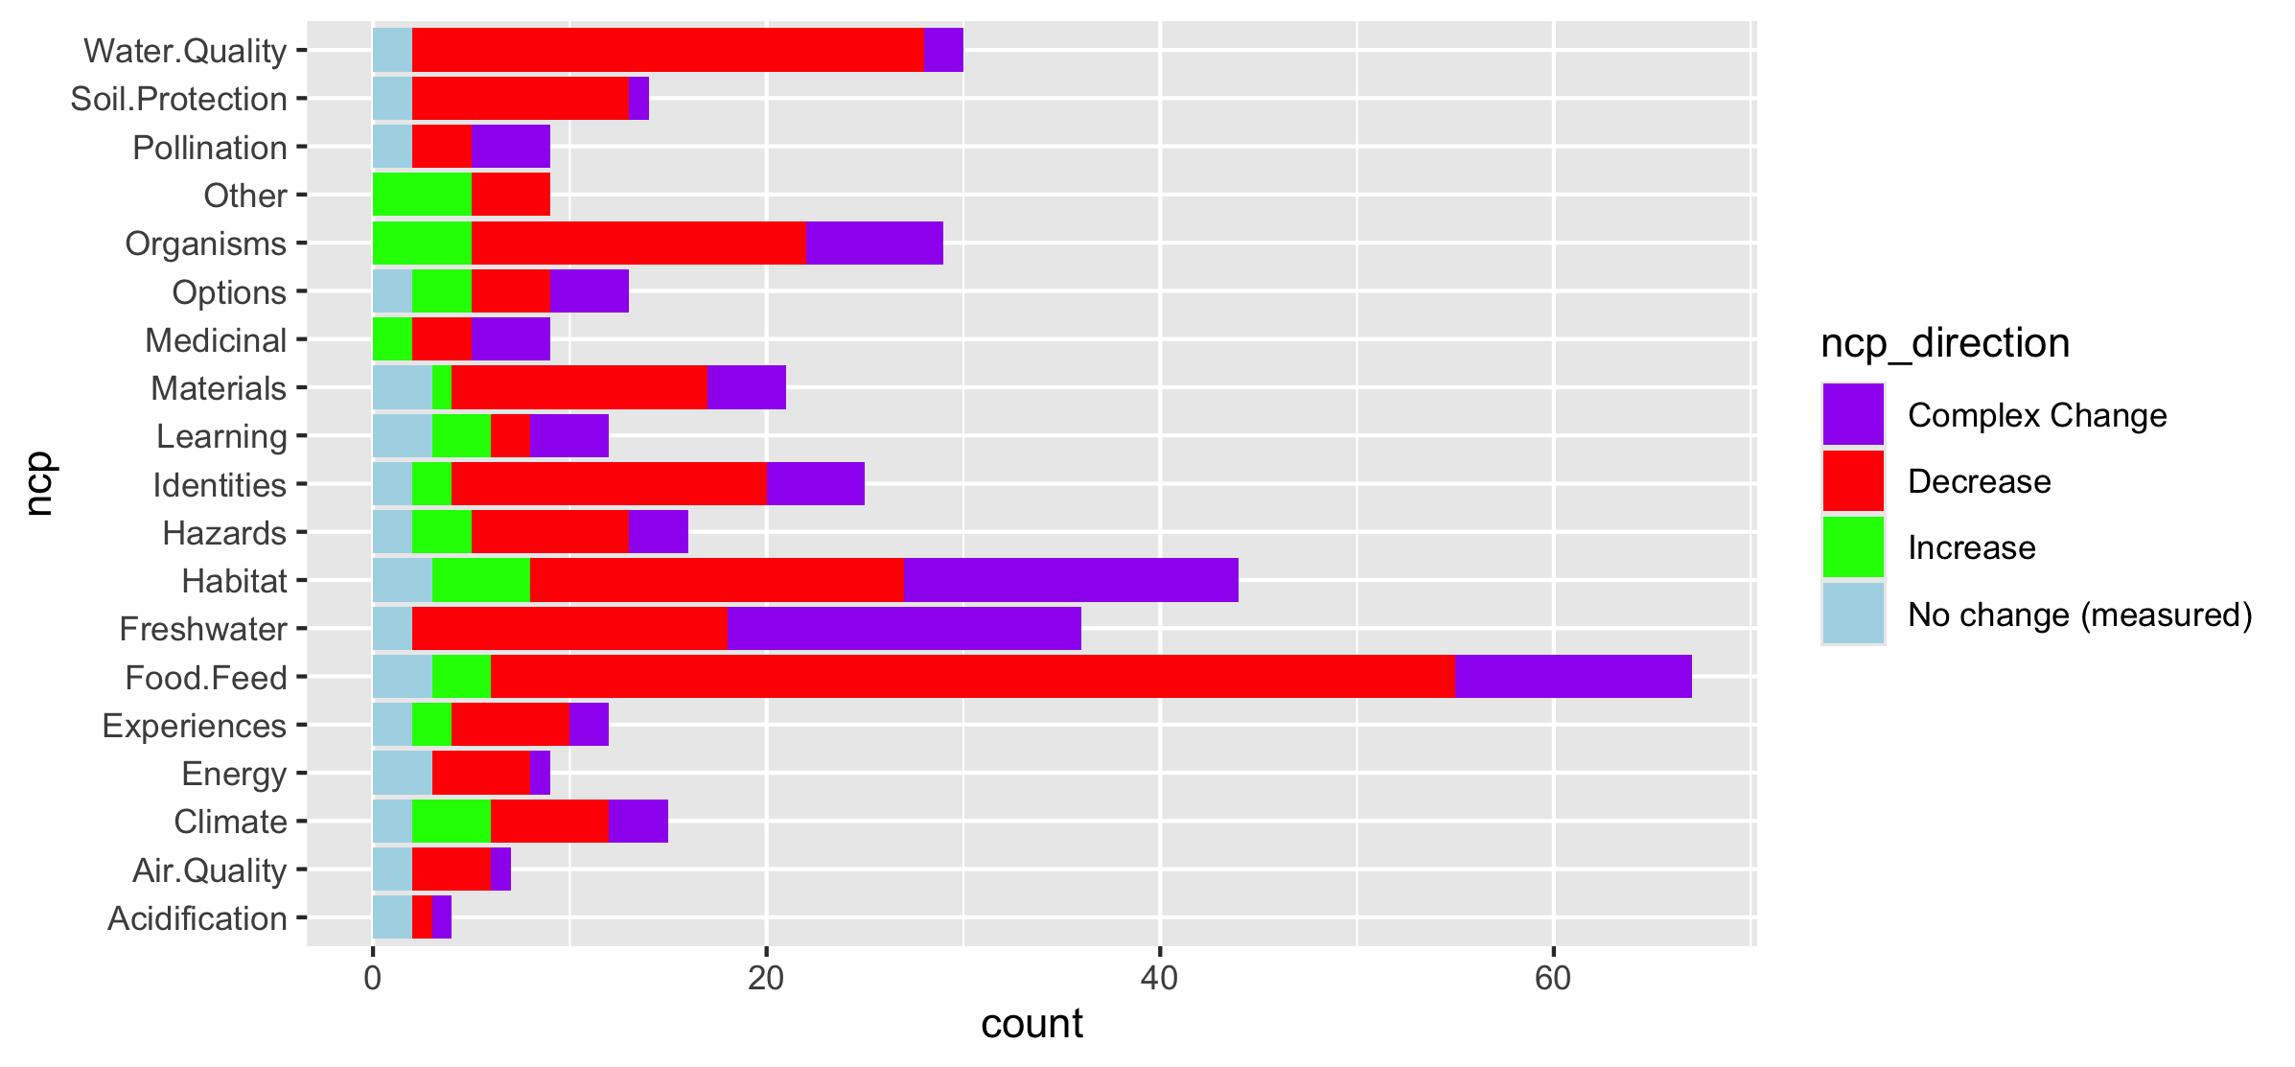
Fix labels

Slide 46
Do by flow type

Slide 47
Fix labels

Slide 48
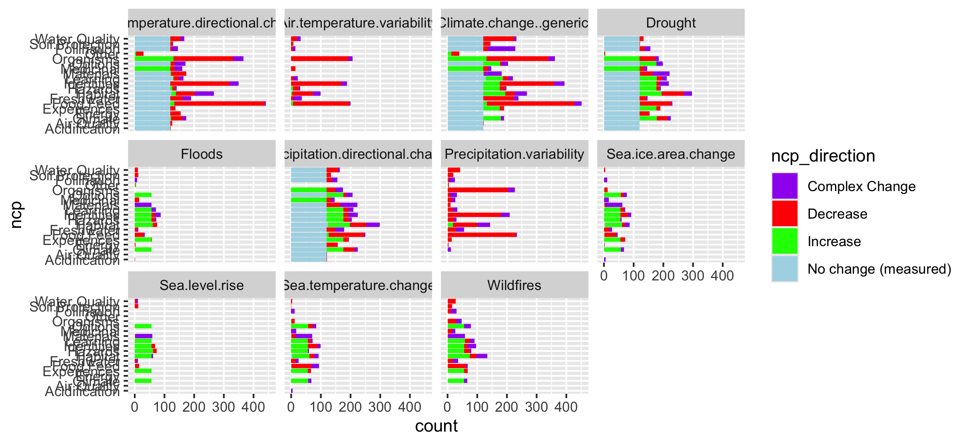

Slide 49
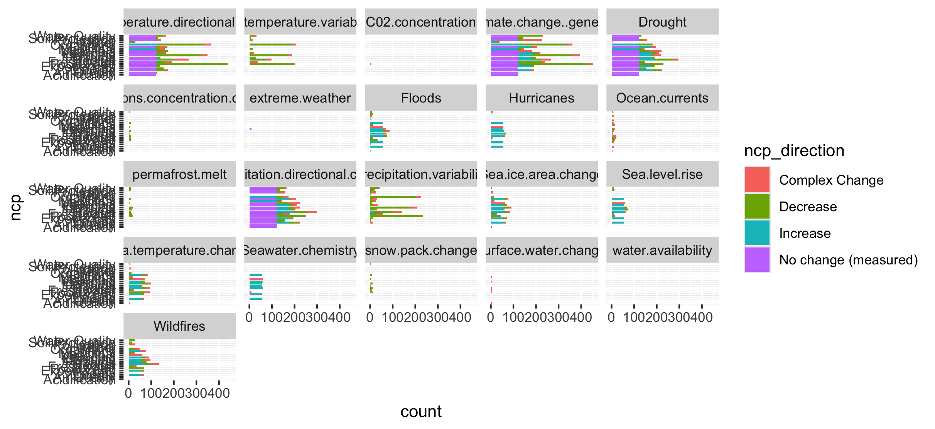
Too many drivers

Slide 50
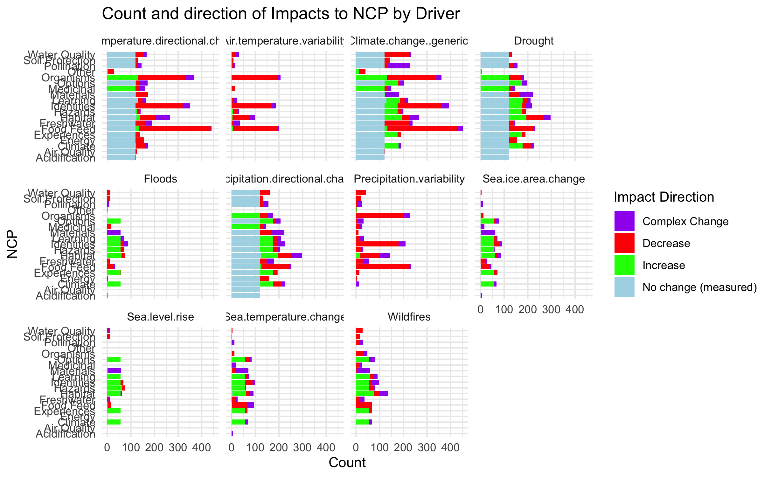

Slide 51
HWB

Slide 52
Connections – how does altered flow relate
Driver~ altered flow (by flow, and subflow – grouped out by flow
Altered flow~ impact (for each category)

